Slide 1
Numeric Computing with Python
Premanand S

Slide 2
What is Numpy?
NUMPY – Numerical Python
Used for numerical computing and scientific data analysis
Array - efficient and convenient data structures
Collection of mathematical functions to manipulate and operate on these arrays

Slide 3
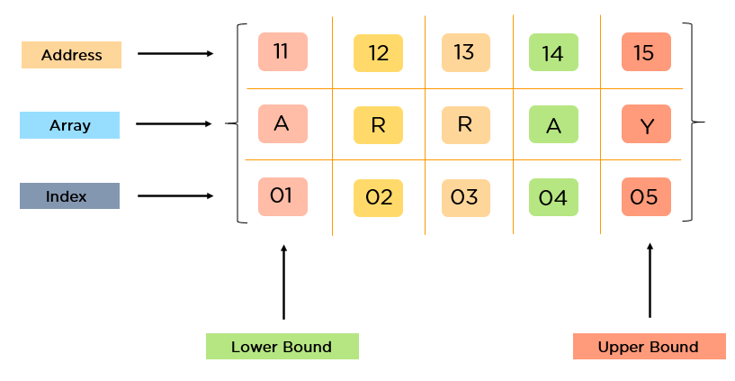
Array?
An array is a data structure that stores a collection of elements of the same type in a contiguous block of memory.
Arrays can be one-dimensional, two-dimensional, or multi-dimensional, depending on the number of dimensions needed to represent the data
It allows efficient storage and manipulation of data, especially when dealing with large amounts of numerical data.

Slide 4
 | Arrays | Lists
Underlying Implementation | NumPy arrays are homogeneous and fixed-size containers optimized for numerical computations. | Python lists are dynamic arrays that can resize and store elements of different data types.
Memory Efficiency | More memory-efficient due to homogeneous data type and optimized storage. | Less memory-efficient due to dynamic resizing and support for different data types.
Performance | Arrays offer faster numerical operations and vectorized computations. | Lists are generally slower for numerical operations and lack vectorized computations.
Flexibility | Arrays are less flexible and have limited functionality compared to lists. | Lists provide more flexibility, support different data types, and have a wider range of built-in methods and operations.
Size and Dimension | Arrays can have multiple dimensions (multi-dimensional arrays). | Lists are one-dimensional, but can contain nested lists to achieve multi-dimensional data structures.
Usage | Suitable for numerical computations, scientific computing, and data analysis. | Versatile and commonly used for general-purpose data storage and manipulation.
Dependencies | NumPy library is required for using NumPy arrays. | No additional dependencies needed as lists are part of the Python standard library.

Slide 5
Why is NumPy important for scientific computing and data analysis?
Efficient numerical operations: efficiently handle large datasets and perform numerical operations - optimized C code at its core, making it significantly faster than traditional Python lists for numerical computations.
Element-wise calculations, linear algebra operations, Fourier transforms, and more
Homogeneous nature of arrays ensures that operations are applied consistently across the data, which is crucial for numerical calculations and analysis
SciPy, Matplotlib, pandas, and scikit-learn

Slide 6
How to install NUMPY?
pip install numpy
conda install numpy
apt-get install python3-numpy (Ubuntu)
yum install numpy (Red hat distribution)

